Slide 1

Welcome to
Intro to Mission & Facilitation
Have your TRAINEE NOTES & SPIRITUAL GIFTS ASSESSMENT in front of you.
Before the training begins, please test your audio. If you are not able to hear anything, please use the chat feature to notify your trainer.

Slide 2


Intro to Mission & Facilitation
Mission: To be a healing community rooted in Christian tradition
supporting each individual’s unique path of transformation and
well-being while promoting social healing through empathetic
connection.

Slide 3
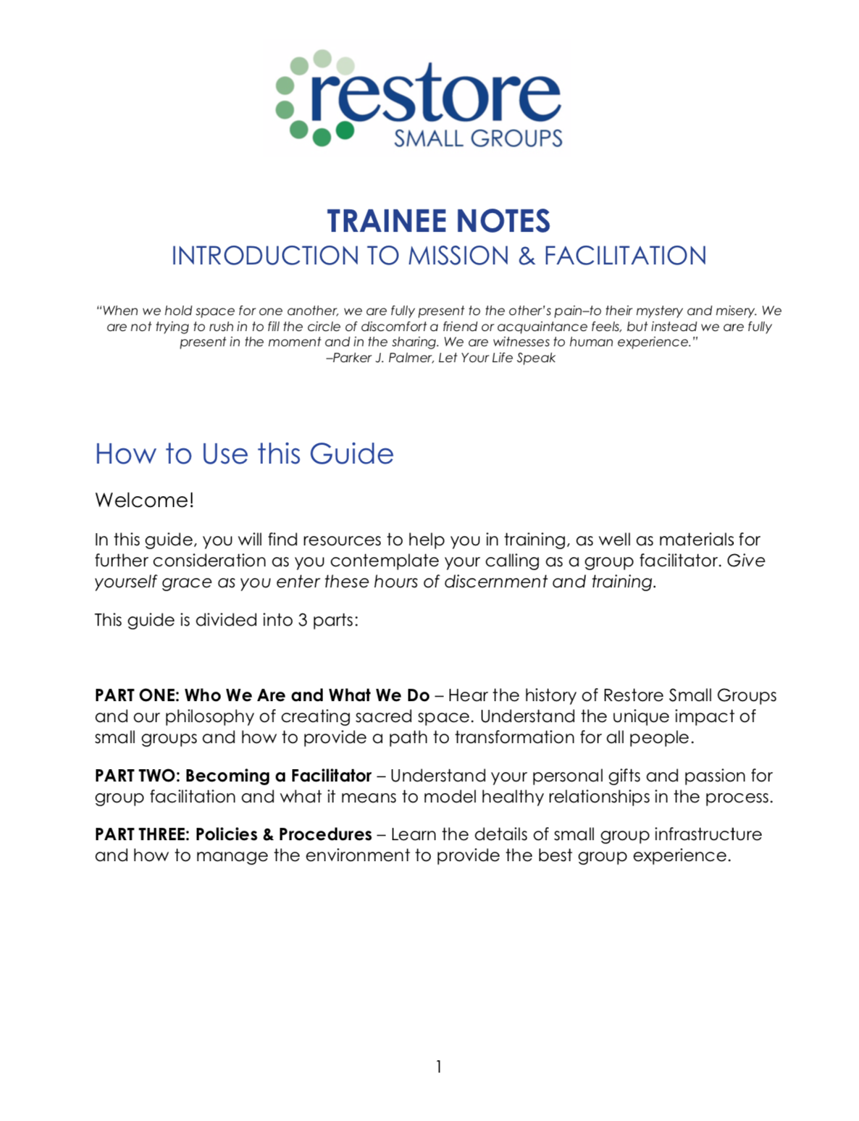
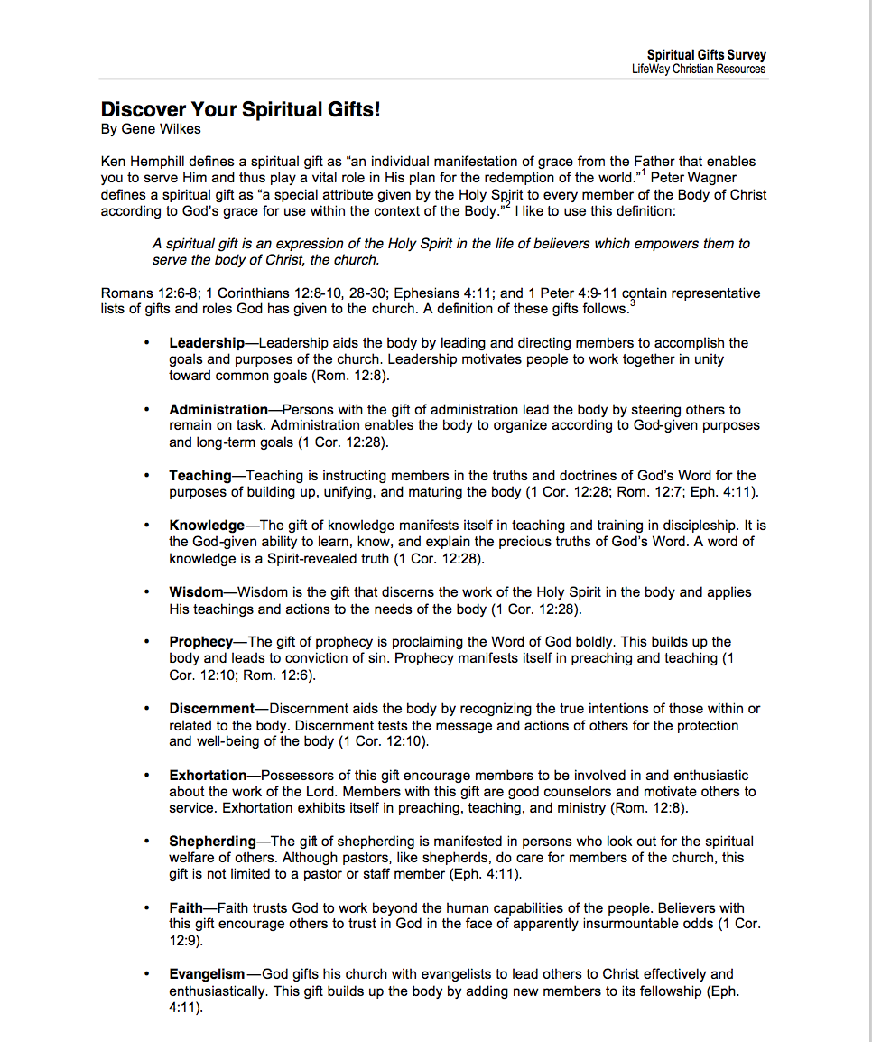
Materials for Training

Slide 4
Introductions
What’s your name?
What’s your favorite movie?
What has brought you to this training?

Slide 5
Goals for Training
INTRO TO MISSION & FACILITATION
01
Who We Are & What We Do
Hear the history of Restore Small Groups and our philosophy of creating sacred space. Understand the unique impact of small groups and how to provide a path to transformation for all people.
Becoming a Facilitator
02
Understand your personal gifts and passion for group facilitation and what it means to model healthy relationships in the process
Policies & Procedures
03
Learn the details of small group infrastructure, and how to manage the environment to provide the best group experience.

Slide 6
Part 1
Who We Are and What We Do
“
“
Change is possible!
Scott Reall
Founder, Restore Small Groups

Slide 7
History of Restore
A participant in a 12 Step group told her friend at Thomas Nelson about her experience.
Scott Reall launches independent from the YMCA, becoming Restore Small Groups.
2000
2004
2005
2015
Present
Restore Ministries founded in the YMCA of Middle Tennessee by Scott Reall. Program centered on 12 Step groups.
Scott Reall publishes 5 books in contract with Thomas Nelson, including
Journey to Freedom.
Restore works with organizations worldwide, including YMCAs, churches, counseling centers, jails, schools, and nonprofits.

Slide 8
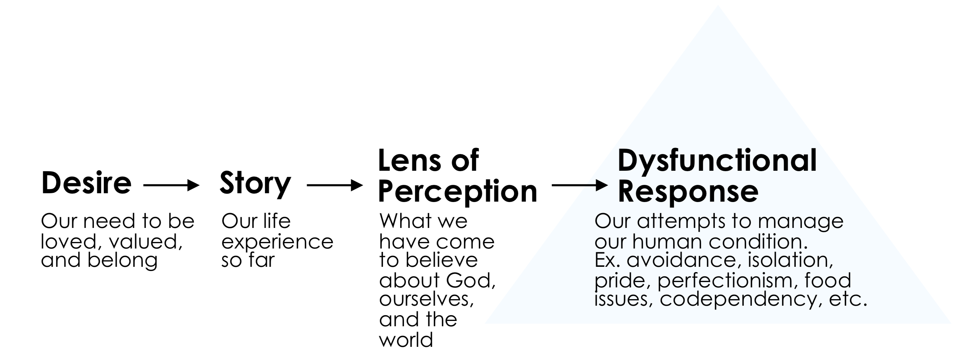
The Human Condition

Slide 9
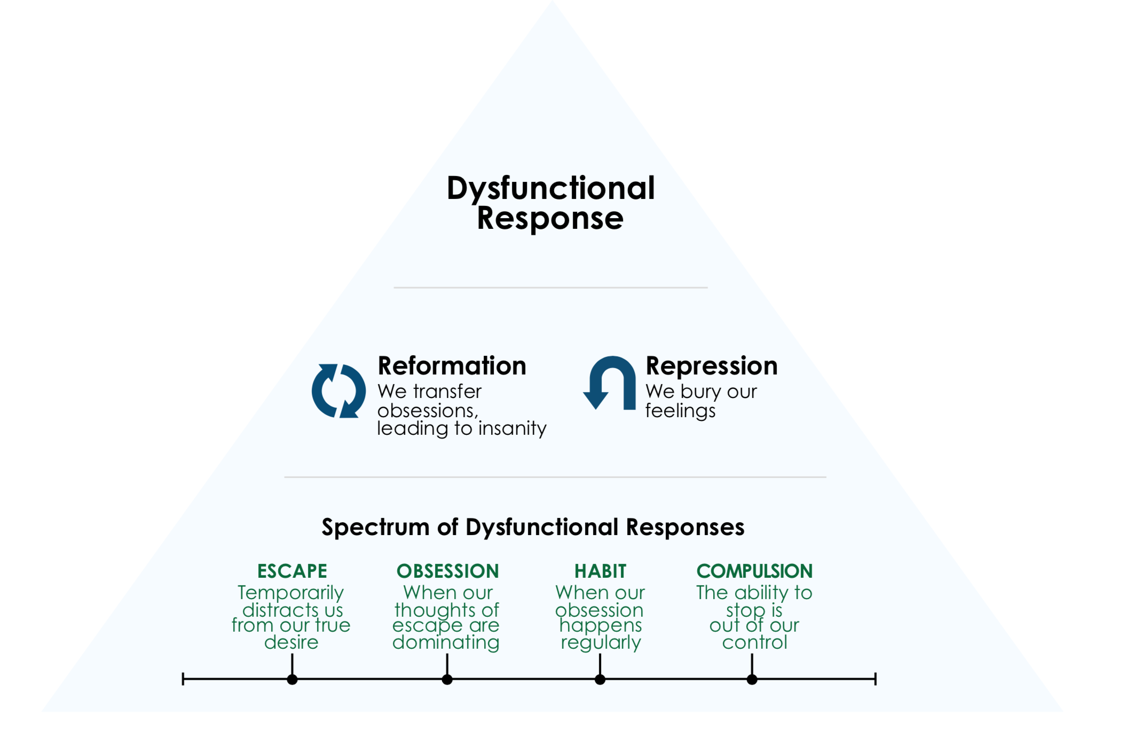
The Human Condition

Slide 10
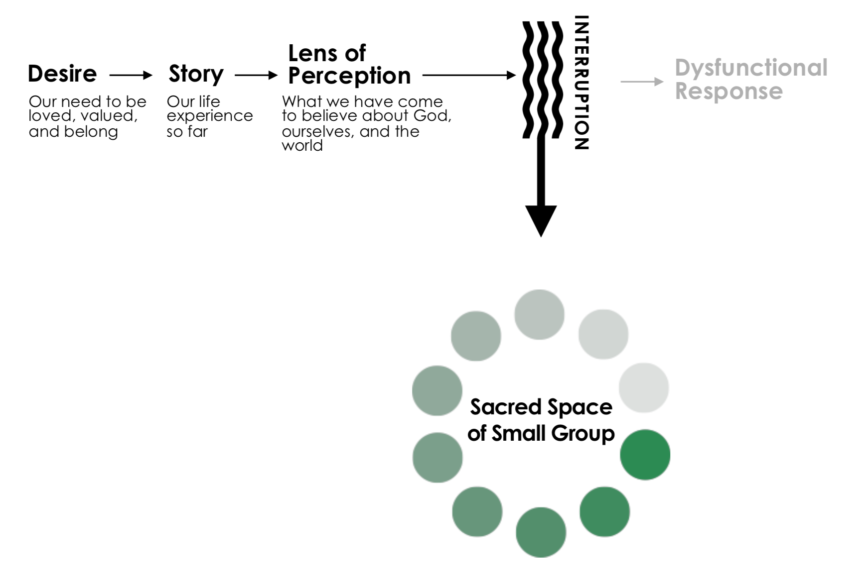
The Process of Transformation

Slide 11
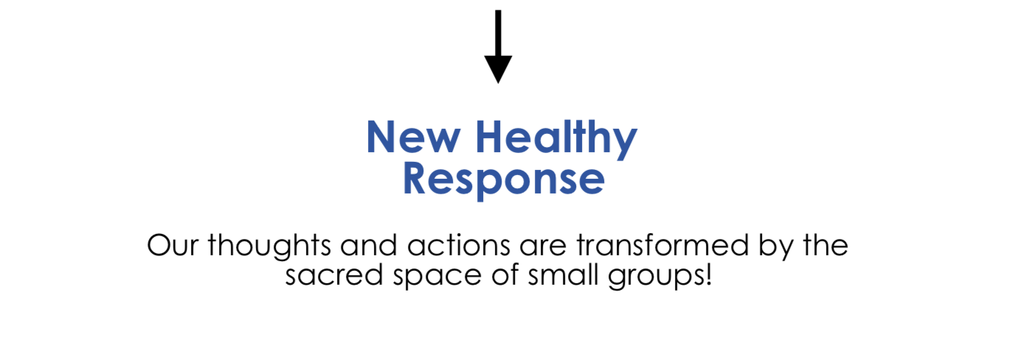

Slide 12
Stages of Change
The Purpose of Journey to Freedom
01
02
03
04
05
Adapted from Changing for Good by
Dr. James Prochaska
Precontemplation
Contemplation
Preparation
Action
Maintenance

Slide 13
What Happens in Group
Examine our life story with God and others
Seek restoration from the pain of our human condition
Give God space to transform our perception
Plan for a new future, a new vision, and a new hope

Slide 14
Why People Join Group
…just a few of the many reasons.
Anxiety
Purpose
Toxic Shame
Significant Life Stories
Doubt
Grief
Isolation

Slide 15




The Nature of Our Small Groups
Book Club
Bible Study
Restore Group
Therapy Group
Little to no structure or accountability
Informal leadership with set curriculum
Facilitated, process-driven, with set curriculum and guidelines
Lead by mental health professionals

Slide 16
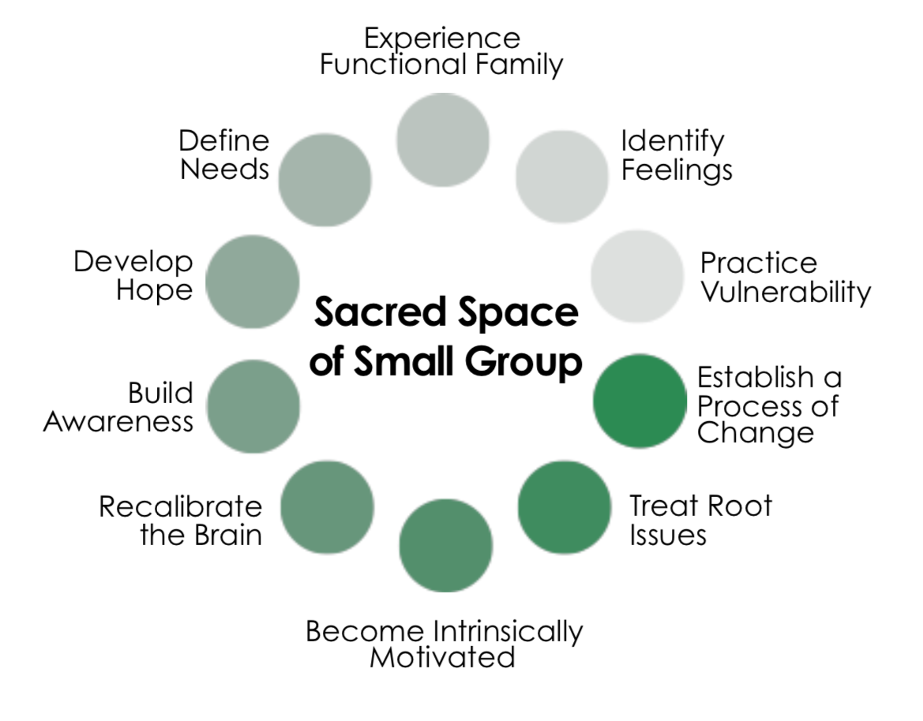
Distinguishing Factors
What Happens in Small Group

Slide 17
What is Inclusive
Christianity?

Slide 18
Inclusive Christianity
No exclusive behavior. Group is for everyone
Infographic Designed
Easy to change colors, photos and Text.
Group facilitates an encounter with God for us and others
Spread God’s love through our affirmation and hope for others

Slide 19
Part 2
Becoming a Facilitator
“
“
Vocation does not come from willfulness.
It comes from listening.
-Parker J. Palmer, Let Your Life Speak

Slide 20
What is vocation?
Passion
Need
Giftings
Vocation

Slide 21
Group Facilitators
Leadership shaped by Christ’s example
Model Healthy Relationships
Understand Yourself
Give Value to Others’ Stories
Be an Example of Inclusive Christianity

Slide 22
Model Healthy Relationships
Be intentional
Embrace humility
Model hope
Practice vulnerability
Resist the desire to rescue others
Be fully present
Use discernment
Deal effectively with conflict

Slide 23
Understand Yourself
Honestly evaluate our motivations
Know your own story
Recognize your gifts

Slide 24
Give Value to Others’ Stories
Practice appropriate self-disclosure
Actively listen
Resist over-spiritualizing or simplifying
Recognize others’ significance

Slide 25
Be an Example of Inclusive Christianity
Seek to understand without judgement
Believe that God works in mysterious ways
Practice compassion without an agenda

Slide 26
Still wrestling with the issues in your
life does not disqualify you from
stepping into this role!

Slide 27
Facilitation is meant to be:
A continual growing process
Practicing self-awareness
A model of progress, not perfection

Slide 28
How to Self-Care ”We cannot give away what we don’t have”
Continually work your own emotional & spiritual process
Know your emotional triggers and needs
Avoid over-commitment
Find a mentor
Know your resources
Learn to let go of control and accept your limitations in group

Slide 29
Be aware of the signs that you have…
ministry fatigue
Losing the ability to be empathetic or sympathetic
Over-sharing in group
Feeling of extreme emotional weariness
Lack of joy

Slide 30
Quick Break!
Be ready to share your top 3 spiritual gifts when we return.

Slide 31
Spiritual Gifts
What are your top 3 spiritual gifts?
How will these gifts help you in being an effective
group facilitator? (your potential)
How might these gifts be over-used in group, causing
challenges for you as a facilitator? (your limitations)

Slide 32
Spiritual Gifts
Potential Limitations
LEADING AND DIRECTING | LEADERSHIP | CONTROL, PRIDE, DO NOT SEEK FEEDBACK
MEETS GOALS WITH ORGANIZATION | ADMINISTRATION | HIGH EXPECTATIONS, RIGIDITY, LOW-RELATIONAL
INSTRUCTING, MATURING IN TRUTH | TEACHING | PRIDE, FOCUS ON FACTS, FEIGN WISDOM
LEARN, KNOW, EXPLAIN TRUTH | KNOWLEDGE | EAGERNESS TO SHARE
DISCERN/APPLY TRUTH, EXPERIENCE | WISDOM | EAGERNESS TO SHARE
PROCLAIMING, PREACHING, WARNING | PROPHECY | HARSHNESS, JUDGEMENT, IMPATIENCE
SENSE TRUE INTENTIONS, EMOTIONALLY INTUITIVE | DISCERNMENT | JUDGEMENT, CONTROL
ENCOURAGEMENT, COUNSEL | EXHORTATION | POOR LISTENING, SIMPLIFICATION, WEARINESS
SPIRITUALLY LOOK OUT FOR OTHERS | SHEPHERDING | OVERBEARING, MANIPULATION
ENCOURAGE TRUST, POWERLESSNESS | FAITH | OVERSIMPLIFICATION, BLIND ACCEPTANCE, PASSIVE
GROW COMMUNITY | EVANGELISM | PUSH OTHERS BEFORE READY
MOTIVATE OUTREACH | APOSTLESHIP | LACK OF RESPECT FOR CULTURE AND BELIEFS
ASSIST WITH PRACTICAL NEEDS | SERVICE/HELPS | OVER-COMMITTMENT, RESENTMENT, WEARINESS
CHEERFUL COMPASSION, EMPATHY | MERCY | BOUNDARY ISSUES, RESCUING, CONFLICT AVOIDANT
FREE AND JOYFUL WORK, RESOURCES | GIVING | PRIDE, MANIPULATION, ENTITLEMENT, RESENTMENT
PUT OTHERS AT EASE, GATHER | HOSPITALITY | OVERCOMMITTMENT, WEARINESS

Slide 33
Part 3
Policies & Procedures
“
“
Management is doing things right; leadership is doing the right things.
Peter F. Drucker

Slide 34
Policies & Procedures
01
Defining Leadership Roles
02
Group Planning
03
Group in Action
04
After Group

Slide 35
DEFINING LEADERSHIP ROLES
Group Coordinators
Are in charge of planning and executing group program
Choose facilitators, find meeting spaces, register participants
Help with support and development of facilitators
Responsible for handling any problems that arise

Slide 36
DEFINING LEADERSHIP ROLES
Facilitators
Have experienced group and are trained
Do not plan group but should be aware of how group is executed
Should be proactive in communicating with group coordinator
Serve either as a “lead facilitator” or as a “co-facilitator,” depending on experience

Slide 37
DEFINING LEADERSHIP ROLES
Commitment of Lead Facilitator
Creates an environment that welcomes intimacy and vulnerability
Is responsible for keeping group space safe and confidential
Maintains clarity on path of discussion and teaching from curriculum
Starts and ends on time
Takes an active role in coaching the co-facilitator throughout the group

Slide 38
DEFINING LEADERSHIP ROLES
Commitment of Co-Facilitator
Is responsible for set-up of group space and general hospitality
Keeps group binder, roster, and handouts for the group
Model participant during discussion
Drives curriculum discussion one or two weeks during group with supervision from Lead Facilitator
Processes any group issues with Lead, being in agreement on how to handle issues

Slide 39
GROUP PLANNING
Scheduling
Consistency is key to start and finish strong
Two facilitators are needed for every group
No more than 1 absence per facilitator
First two weeks of group and last two weeks of group must be without a break

Slide 40
GROUP PLANNING
Meeting Space
Protects confidentiality
Circle of chairs, no objects in the center
Quiet and ideal for conversation without interruption
Allows participants to enter with some anonymity

Slide 41
GROUP PLANNING
Gender of Group
Decide Male, Female, or Coed before advertising
If a coed group becomes gender-specific or a gender-specific group becomes coed, all participants need to be notified before first group session
Must have male and female facilitator for co-ed group

Slide 42
GROUP PLANNING
Don’t Force the Process
Group minimum is 5 participants not including the facilitators
Group maximum is ten participants
Communicate with your coordinator if group numbers are lower than expected so that a decision can be made to continue or not
Do not worry if the group does not make. Timing is always a part of the group process. It is more important that people have the best group experience possible
God is in control of getting people into group.

Slide 43
GROUP PLANNING
Setting Group Expectations
Participants should have a desire to change.
Be aware of participants who joined group for unhealthy reasons (e.g. spouse wants another spouse in group, parent wants an adult child in group, friend thinks another friend needs help, etc.) and communicate to your coordinator if these dynamics need to be addressed.
If you sense that a group member might need emotional help that group cannot support, make your group coordinator aware of this so it can be addressed.

Slide 44
GROUP IN ACTION
First Meeting
Create an atmosphere of enthusiasm, confidence, and command.
Sensitive to anxiety, nervousness, fear, and skepticism.
Keep body language open and present
Consider getting help for first-meeting logistics for groups of 7+
Use “Moment of Hope” video, if you so choose. These are videos featuring Scott Reall explaining each week of Journey to Freedom. These are optional but encouraged.

Slide 45
GROUP IN ACTION
Validate
“If you are feeling nervous about sharing in front of a group, that’s normal.”
“This can be a lot to take in. Do the best you can.” “Your willingness to show up today and start this journey is a big deal.” “The first meeting is generally the hardest. It’s okay if you feel nervous.”
END: “You may go home and feel anxious about what you shared and this experience.”
If you can predict it, you can prevent it!

Slide 46
GROUP IN ACTION
Group Binder
Process of Transformation to explain purpose of group
Group Guidelines to protect the safety and sacredness of group sharing
Feelings Chart for weekly check-ins
The Toxic Shame Cycle handout for Week 5 discussion
The Stages of Grief handout for Week 7 discussion
Program Evaluations for feedback
Extra supplies

Slide 47
GROUP IN ACTION
Structure
Meetings conclude in 8 weeks. Avoid going over this amount of time since participants have planned their calendars accordingly. Finishing on time is a good example of healthy boundaries.
Groups close in the second week to assure safety and bonding.
Emphasize that regular group attendance is important for the best experience. It is recommended that participants do not miss more than 2 group meetings in 8 weeks. If they miss more, discuss this with your coordinator.

Slide 48
GROUP IN ACTION
Online Group
An effective way to serve a broader audience
Operate very similarly to in person groups
Uses an online meeting platform like Zoom or Teams
Facilitators need to be familiar with technology and managing the
meeting space ahead of time
A plan needs to be in place for handling participant technology issues
Registration needs to include clear communication around best practices
Materials need to be mailed ahead of time
Post-group follow-up on feedback/data and affirmations

Slide 49
GROUP IN ACTION
Facilitator Responses
Should come from a place of sympathy, empathy, and affirmation
“Thank you.”
“I’m so sorry you had to go through that.” “I am so glad you shared that.” “I’m sorry you had to carry that for so long.”
“Thank you for trusting us with that story.”
Should not compare stories or move forward too quickly (rescuing)

Slide 50
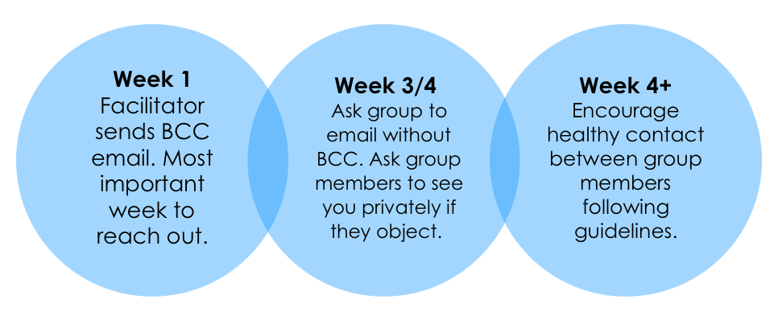
GROUP IN ACTION
Creating Community

Slide 51
GROUP IN ACTION
Creating Community
Group strategically promotes intimate relationships.
Beware of texting and social media
During the weeks of the group meeting, encourage participants to focus on relationship-building that is strictly platonic and exemplifies healthy relationship boundaries

Slide 52
GROUP IN ACTION
The Importance of Closing Well
Close each session with ceremony, something dependable you do every time.
On the last week of group, the group will share affirmations with each other. This is a special moment for participants in the group experience.
Provide next steps for participants.

Slide 53
GROUP IN ACTION
Managing Group Well
Guideline Enforcement:
• The majority of group issues can be addressed by:
Following best practices of policies in place
Enforcing the guidelines

Slide 54
GROUP IN ACTION
Managing Group Well
Waiver and Reporting:
You should become familiar with the reporting laws in your area. Generally, confidentiality in group is upheld
for most disclosure. However, it may be waived in certain cases. Below is the confidentiality waiver that
Restore includes on every registration and participants must agree before proceeding further. If you have an
incident in group where you feel unclear on the information disclosed, seek legal counsel.
Restore Small Groups are offered by group facilitators who have participated in a Restore group themselves and been trained to lead. We hold ourselves to the highest standards of conduct within our group process.
However, our groups are not offered as professional therapy and should not substitute for the opinion of a
licensed professional counselor. We honor and value confidentiality in our groups.
However, we are obligated to waive confidentiality if there are:
Suspicion of child, elder, or disabled individual abuse - We reserve the right to report actual or suspected
child, elder, or disabled individual abuse of any type to the proper authorities.
Threats to harm self or others - We reserve the right to disclose to the appropriate person, agency or civil authorities any threats of harm that a person may attempt or desire to do to one’s self or to others.

Slide 55
GROUP IN ACTION
Challenging Participants
Example: The Monopolizer
Unable to adhere to the guidelines to limit sharing time
Lack of social awareness
Feels the need to rescue others from silence

Slide 56
GROUP IN ACTION
Techniques to Correct
Before Feelings Check-In, refer back to the guideline on sharing time
Reiterate the importance of silence
At the beginning of group, adopt a signal of raising hand to indicate wrap-up
Redirect the conversation
Intentionally use go-around questions
Consult your group coordinator to see if the issue needs to be addressed outside of group

Slide 57
GROUP IN ACTION
Other Challenging Participants
For more information on the participants below, consult your Building Healing Communities guide (given upon completion of Facilitator Training Part 2)
• Over-Spiritualizer
• Complainer • Non-Participants
• Cross-Talker
• Rescuer

Slide 58
AFTER GROUP
The Importance of Closing Well
Identify potential facilitators and communicate to your group coordinator
Demonstrated healthy boundaries
Connected personally to curriculum and small group environment
Was able to stay current in the reading and writing homework
Articulates well to the group
Process the overall experience with all facilitators
Go over program evaluation forms with site coordinator

Slide 59
So, am I a facilitator now?
(Hint: Just one more step!)

Slide 60
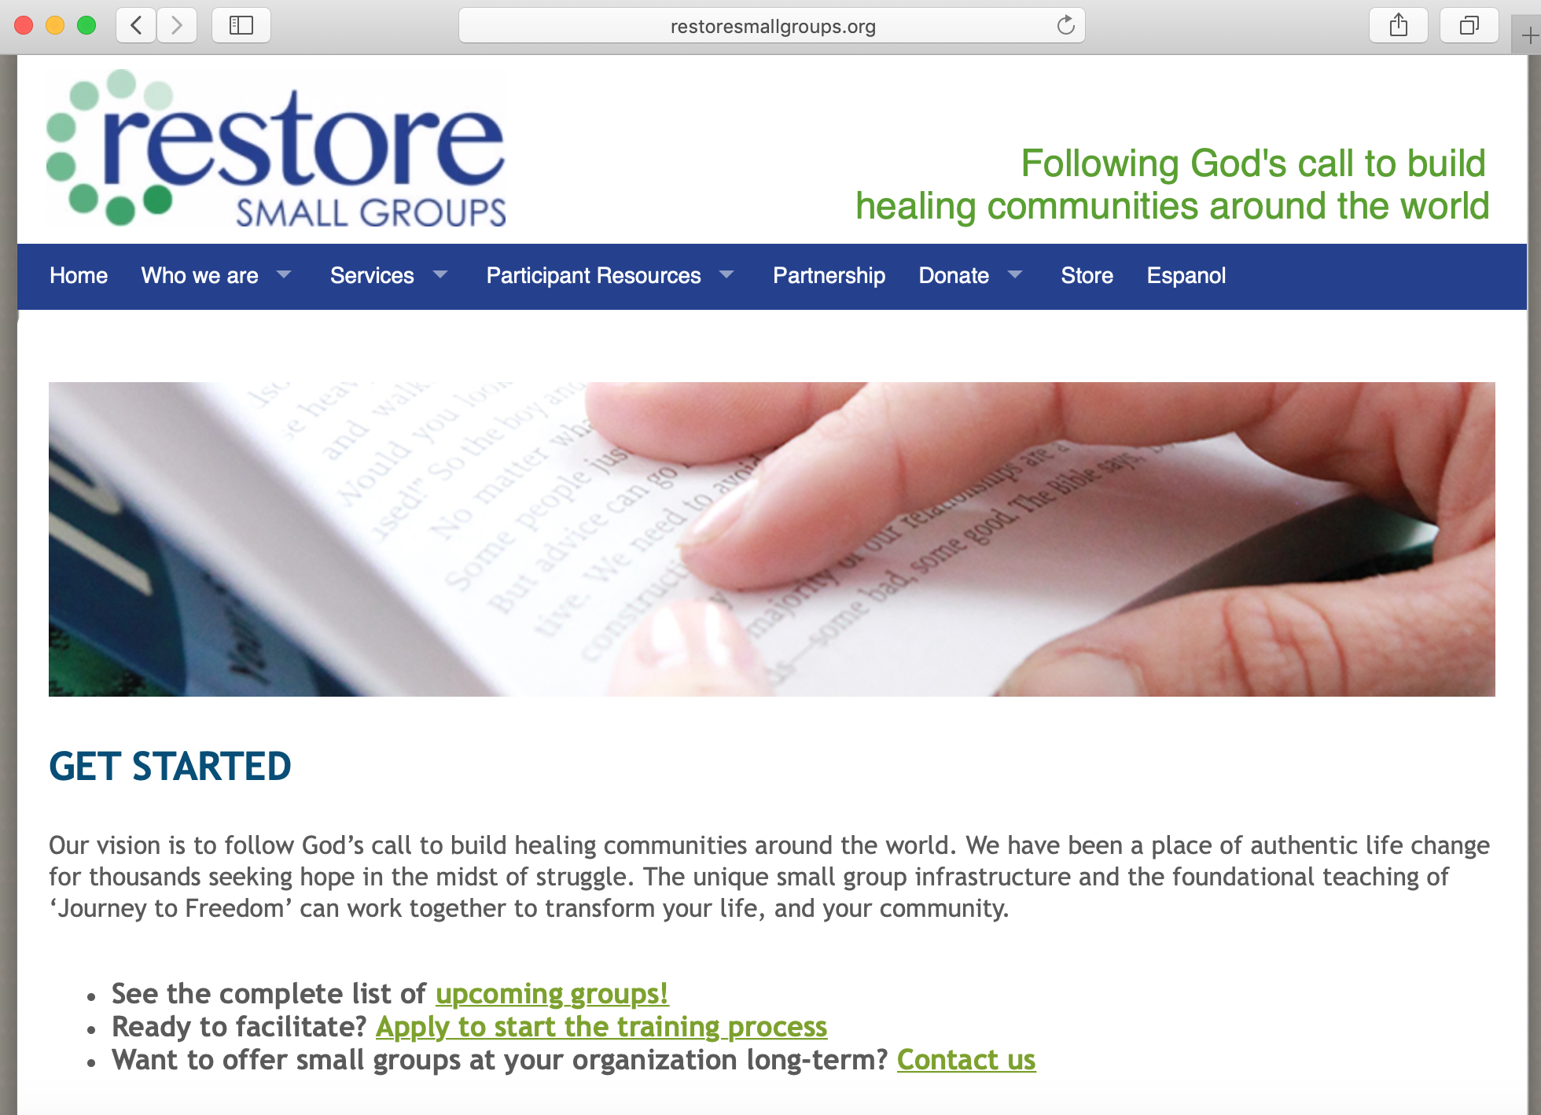
Developing as a Facilitator
REQUIREMENTS
Complete Intro to Mission & Facilitation Training
Complete Journey to Freedom Curriculum Intensive Training

Slide 61
Developing as a Facilitator
RECOMMENDATIONS
Facilitate a minimum of once annually

Slide 62


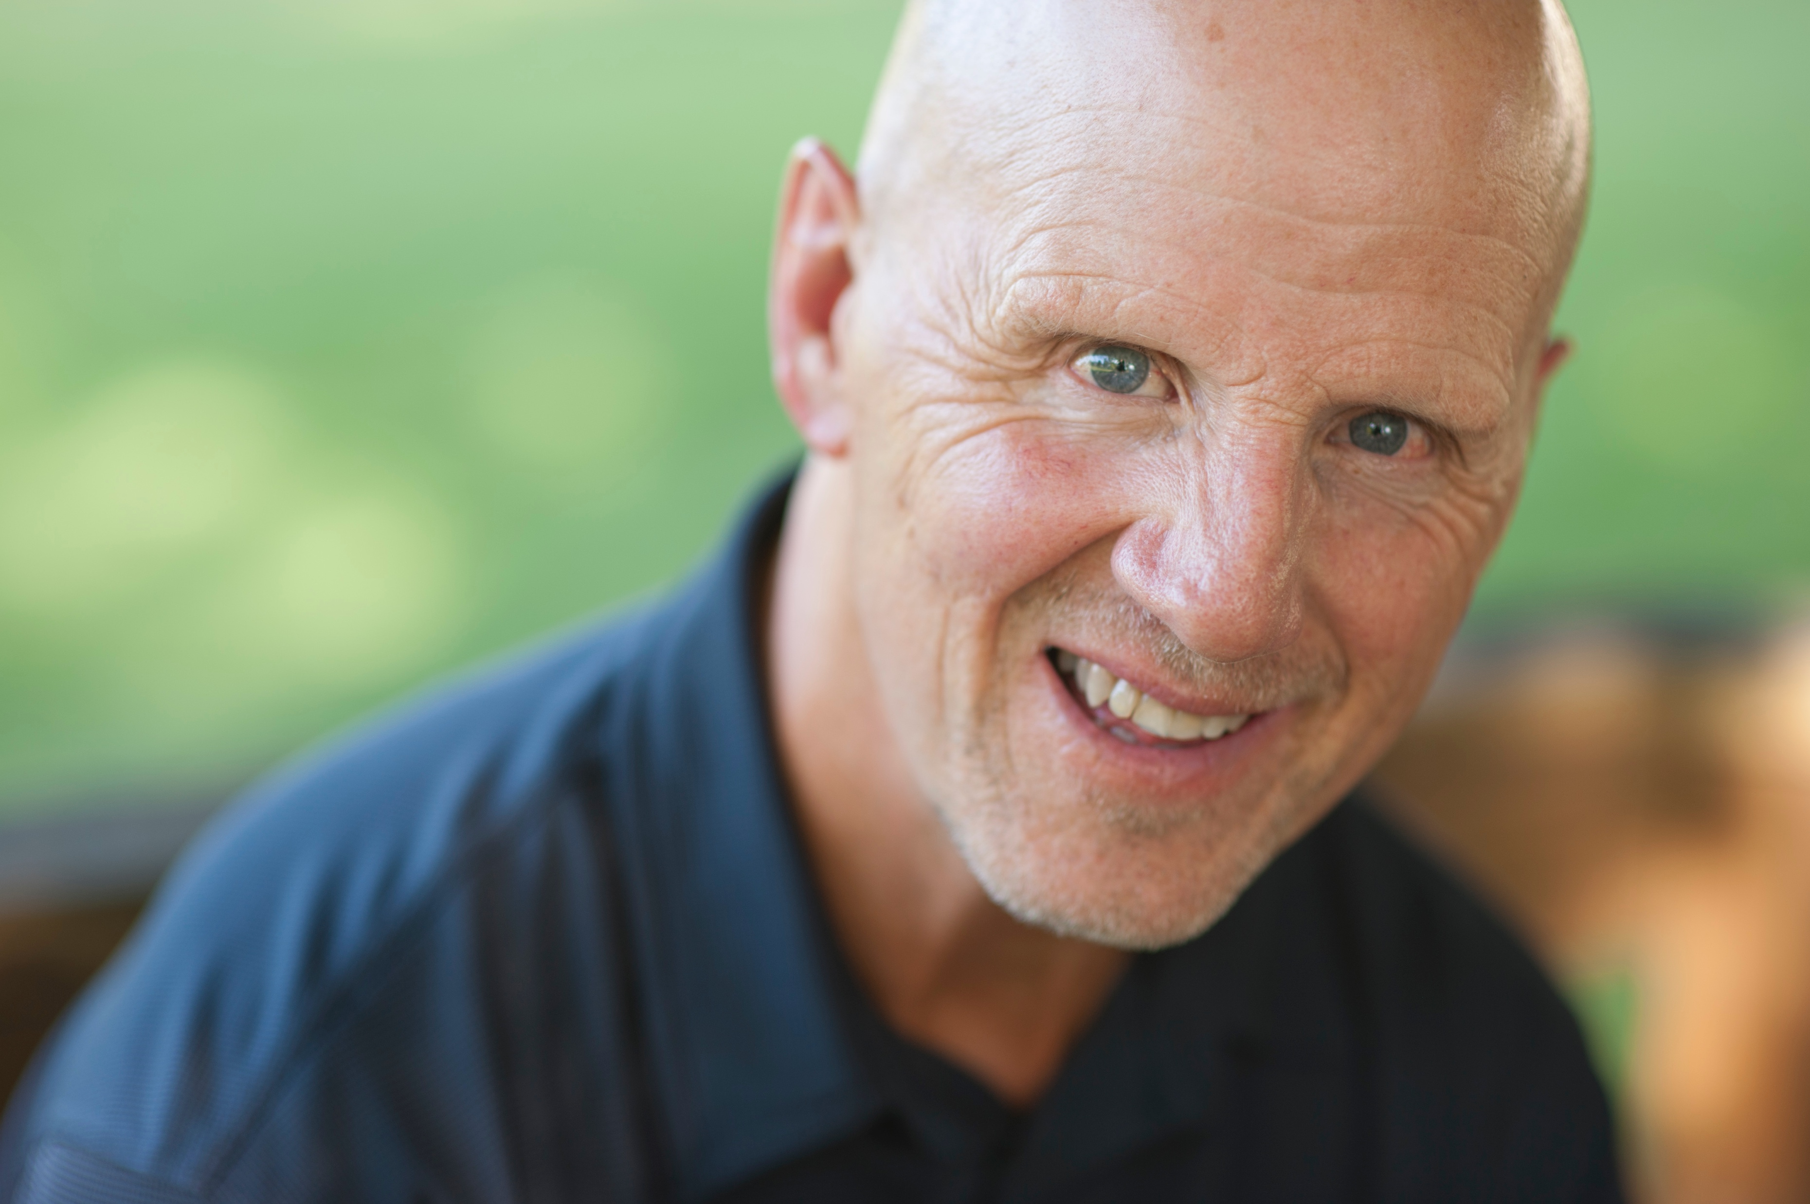
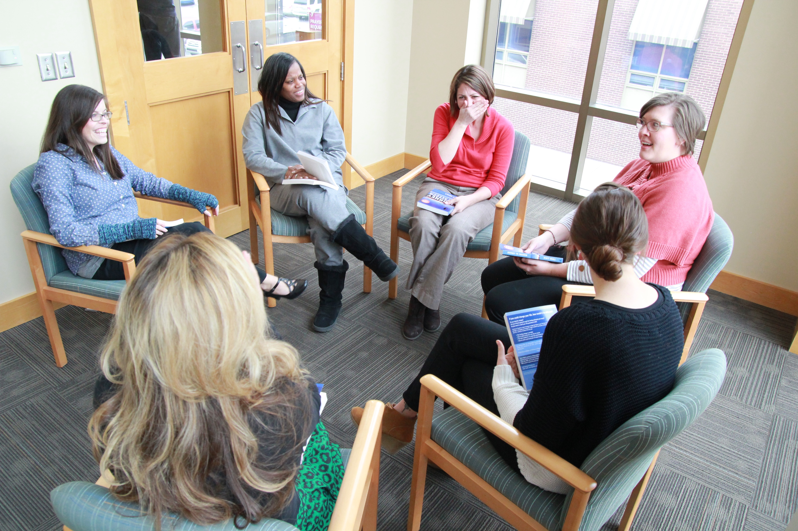
Questions?

